Slide 1
NCTU IEE 5046 高頻電路設計與實驗 Allegro PCB Editor - Create Package Symbol
Lecturer: Professor Yu-Jiu Wang
TA: 李道一michael@rfvlsi.ee.nctu.edu.tw
Document coauthor: Jon-Jin Chen

Slide 2
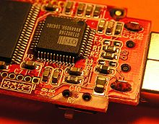
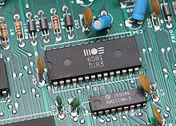
Package Symbol
Two category of footprints:
SMT – Surface Mount Technology
TH – Through Hole
Surface Mount Technology
Through Hole

Slide 3
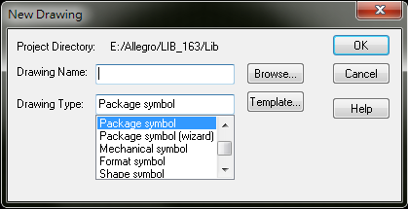
New Package Symbol
Menu -> File -> New
Remember to save package symbol at $psmpath

Slide 4
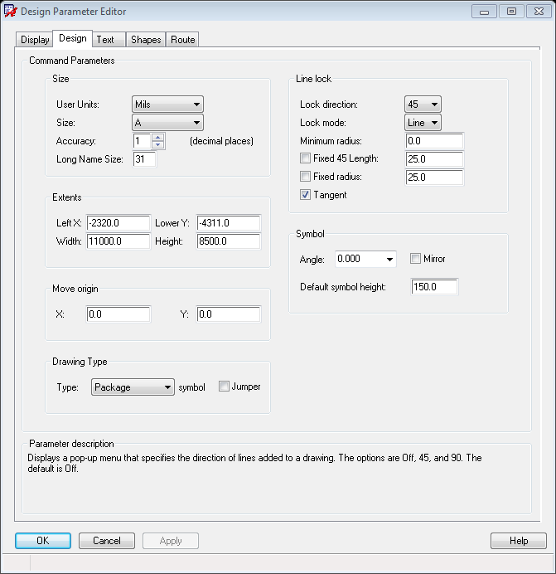
Basic Environment Setup
Menu-> Setup -> Design Parameters
Grid
Turn on
1 mil
Units
Use English units (mil) to avoid conversion errors

Slide 5
Look For Datasheet
Digikey
http://www.digikey.com
Mouser
http://www.mouser.com
Extract Dimensions
Use professional version of Adobe Acrobat
Use Autocad
By hand

Slide 6
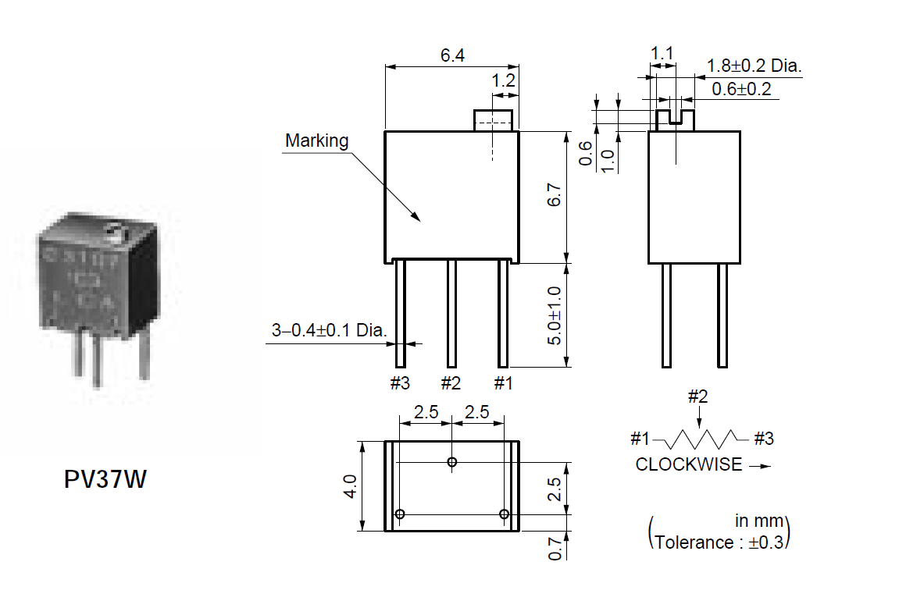
Through Hole Example
Using: Murata PV 37 Series
Be careful of the units
Define pin numbers as datasheet suggests

Slide 7
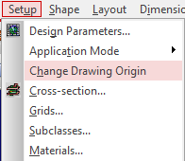
Through Hole Example
Steps:
Define Origin
Center of n-th pin
Package Edge
Change origin dynamically for convenience
Write down dimensions on a draft paper first
Prepare pad-stack with pad designer
Configure drill holes on pad-stack
Place Pads

Slide 8
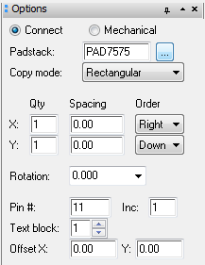
Place Pins for a Symbol
把Pin放到Package上
Layout -> Pins
從右邊的option選擇要用的Padstack
Manually assign coordinate for accuracy
P : Pick Point
A : Toggle Absolute /Relative Mode

Slide 9
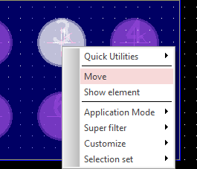
Modify Pins After Placement
還有Rotation的角度(選完後再按一次 Layout -> Pins)
Use context menu to move, than use context menu again to rotate
還有最重要的Pin #
要和capture上的腳位一模一樣
Use Edit text to change Pin #

Slide 10
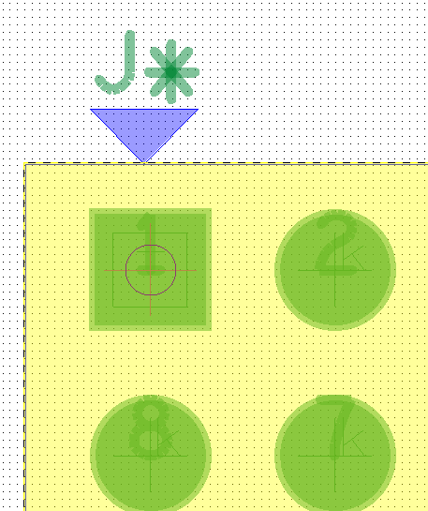

Assign Reference Designator (RefDes)
設定Device Type和Ref Des
Add -> Text (任意字串e.g. J*)
在右邊Option選擇Device Type/ Silkscreen_Top放在第一個pin

Slide 11

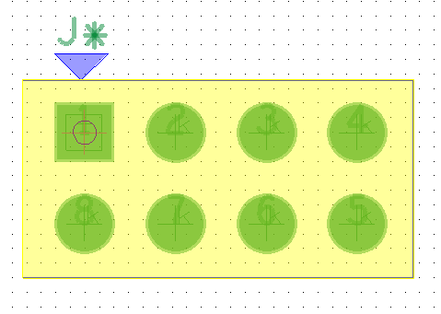
Assign Package Boundaries
選擇Setup -> Areas -> Package Boudarys 後,選矩形 把整個元件包起來(Pin的部分)

Slide 12
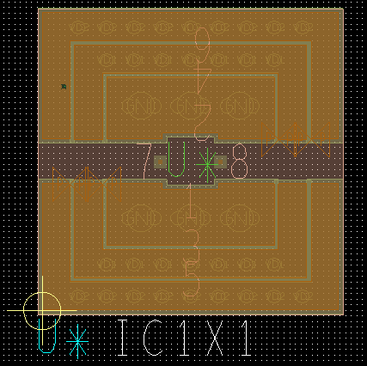
Create Device File and Symbol (*.psm)
存檔: File -> Save
製作元件: File -> Create Device

